Slide 1
Edge detection
Can perform in 3 ways:
Sobel filter
sobel_horizontal = cv2.Sobel(img, cv2.CV_64F, 1, 0, ksize=5)
sobel_vertical = cv2.Sobel(img, cv2.CV_64F, 0, 1, ksize=5)
Laplacian filter
laplacian = cv2.Laplacian(img, cv2.CV_64F)
Canny filter
canny = cv2.Canny(img, 50, 240)

Slide 2
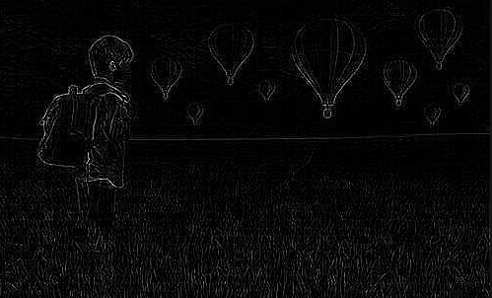
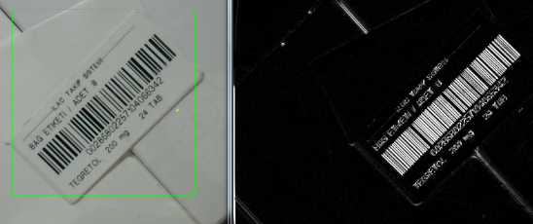
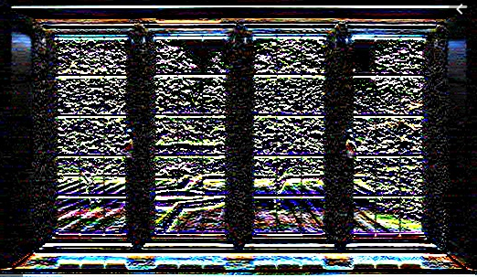
Sobel
Laplacian
Scharr

Slide 3
Sharpening
To sharpen the edges in the image.
To enhance the edges in an image that's not crisp.
Here are some images to give you an idea of what the image sharpening process looks like:

Slide 4
As you can see in the preceding figure, the level of sharpening depends on the type of kernel we use.
We have a lot of freedom to customize the kernel here, and each kernel will give you a different kind of sharpening.
To just sharpen an image, like we are doing in the top right image in the preceding picture, we would use a kernel like this:

Slide 5
If we want to do excessive sharpening, like in the bottom left image, we would use the following kernel:
But the problem with these two kernels is that the output image looks artificially enhanced. If we want our images to look more natural, we would use an Edge Enhancement filter.
The underlying concept remains the same, but we use an approximate Gaussian kernel to build this filter.
It will help us smoothen the image when we enhance the edges, thus making the image look more natural.

Slide 6
Here is the code to achieve the effects applied in the preceding screenshot:
import cv2
import numpy as np
img = cv2.imread('input.jpg')
cv2.imshow('Original', img)
# generating the kernels
kernel_sharpen_1 = np.array([[-1,-1,-1], [-1,9,-1], [-1,-1,-1]])
kernel_sharpen_2 = np.array([[1,1,1], [1,-7,1], [1,1,1]])
kernel_sharpen_3 = np.array([[-1,-1,-1,-1,-1],
[-1,2,2,2,-1],
[-1,2,8,2,-1],
[-1,2,2,2,-1],
[-1,-1,-1,-1,-1]]) / 8.0
# applying different kernels to the input image
output_1 = cv2.filter2D(img, -1, kernel_sharpen_1)
output_2 = cv2.filter2D(img, -1, kernel_sharpen_2)
output_3 = cv2.filter2D(img, -1, kernel_sharpen_3)
cv2.imshow('Sharpening', output_1)
cv2.imshow('Excessive Sharpening', output_2)
cv2.imshow('Edge Enhancement', output_3)
cv2.waitKey(0)
If you noticed, in the preceding code, we didn't divide the first two kernels by a normalizing factor. The reason is because the values inside the kernel already sum up to 1, so we are implicitly dividing the matrices by 1.

Slide 7
Understanding the pattern
You must have noticed a common pattern in image filtering code examples. We build a kernel and then use filter2D to get the desired output. That's exactly what's happening in this code example as well! You can play around with the values inside the kernel and see if you can get different visual effects. Make sure that you normalize the kernel before applying it, or else the image will look too bright because you are artificially increasing the pixel values in the image.

Slide 8
Embossing
An embossing filter will take an image and convert it into an embossed image. We basically take each pixel and replace it with a shadow or a highlight. Let's say we are dealing with a relatively plain region in the image. Here, we need to replace it with plain gray color because there's not much information there. If there is a lot of contrast in a particular region, we will replace it with a white pixel (highlight), or a dark pixel (shadow), depending on the direction in which we are embossing.
This is what it will look like:

Slide 9
Let's take a look at the code and see how to do this:
import cv2
import numpy as np
img_emboss_input = cv2.imread('input.jpg')
# generating the kernels
kernel_emboss_1 = np.array([[0,-1,-1],
[1,0,-1],
[1,1,0]])
kernel_emboss_2 = np.array([[-1,-1,0],
[-1,0,1],
[0,1,1]])
kernel_emboss_3 = np.array([[1,0,0],
[0,0,0],
[0,0,-1]])
# converting the image to grayscale
gray_img = cv2.cvtColor(img_emboss_input,cv2.COLOR_BGR2GRAY)
# applying the kernels to the grayscale image and adding the offset
output_1 = cv2.filter2D(gray_img, -1, kernel_emboss_1) + 128
output_2 = cv2.filter2D(gray_img, -1, kernel_emboss_2) + 128
output_3 = cv2.filter2D(gray_img, -1, kernel_emboss_3) + 128
cv2.imshow('Input', img_emboss_input)
cv2.imshow('Embossing - South West', output_1)
cv2.imshow('Embossing - South East', output_2)
cv2.imshow('Embossing - North West', output_3)
cv2.waitKey(0)

Slide 10
If you run the preceding code, you will see that the output images are embossed. As we can see from the kernels above, we are just replacing the current pixel value with the difference of the neighboring pixel values in a particular direction. The embossing effect is achieved by offsetting all the pixel values in the image by 128. This operation adds the highlight/shadow effect to the picture.

Slide 11
Erosion and dilation
Erosion and dilation are morphological image processing operations
Let's see what these operations look like:

Slide 12
Following is the code to achieve this:
import cv2
import numpy as np
img = cv2.imread('input.png', 0)
kernel = np.ones((5,5), np.uint8)
img_erosion = cv2.erode(img, kernel, iterations=1)
img_dilation = cv2.dilate(img, kernel, iterations=1)
cv2.imshow('Input', img)
cv2.imshow('Erosion', img_erosion)
cv2.imshow('Dilation', img_dilation)
cv2.waitKey(0)

Slide 13
Afterthought
OpenCV provides functions to directly erode and dilate an image. They are called erode and dilate, respectively. The interesting thing to note is the third argument in these two functions. The number of iterations will determine how much you want to erode/dilate a given image. It basically applies the operation successively to the resultant image. You can take a sample image and play around with this parameter to see what the results look like.

Slide 14
Creating a vignette filter
Using all the information we have, let's see if we can create a nice vignette filter. The output will look something like the following:

Slide 15
Here is the code to achieve this effect:
import cv2
import numpy as np
img = cv2.imread('input.jpg')
rows, cols = img.shape[:2]
# generating vignette mask using Gaussian kernels
kernel_x = cv2.getGaussianKernel(cols,200)
kernel_y = cv2.getGaussianKernel(rows,200)
kernel = kernel_y * kernel_x.T
mask = 255 * kernel / np.linalg.norm(kernel)
output = np.copy(img)
# applying the mask to each channel in the input image
for i in range(3):
output[:,:,i] = output[:,:,i] * mask
cv2.imshow('Original', img)
cv2.imshow('Vignette', output)
cv2.waitKey(0)

Slide 16
What's happening underneath?
The Vignette filter basically focuses the brightness on a particular part of the image and the other parts look faded.
need to filter out each channel in the image using a Gaussian kernel.
OpenCV provides a function to do this, which is called getGaussianKernel.
Need to build a 2D kernel whose size matches the size of the image.
The second parameter of the function, getGaussianKernel, is interesting.
It is the standard deviation of the Gaussian and it controls the radius of the bright central region. You can play around with this parameter and see how it affects the output.
Once we build the 2D kernel, we need to build a mask by normalizing this kernel and scaling it up, as shown in the following line:
mask = 255 * kernel / np.linalg.norm(kernel)
This is an important step because if you don't scale it up, the image will look black. This happens because all the pixel values will be close to 0 after you superimpose the mask on the input image. After this, we iterate through all the color channels and apply the mask to each channel.

Slide 17
How do we move the focus around?
We now know how to create a vignette filter that focuses on the center of the image. Let's say we want to achieve the same vignette effect, but we want to focus on a different region in the image, as shown in the following figure:

Slide 18
All we need to do is build a bigger Gaussian kernel and make sure that the peak coincides with the region of interest. Following is the code to achieve this:
import cv2
import numpy as np
img = cv2.imread('input.jpg')
rows, cols = img.shape[:2]
# generating vignette mask using Gaussian kernels
kernel_x = cv2.getGaussianKernel(int(1.5*cols),200)
kernel_y = cv2.getGaussianKernel(int(1.5*rows),200)
kernel = kernel_y * kernel_x.T
mask = 255 * kernel / np.linalg.norm(kernel)
mask = mask[int(0.5*rows):, int(0.5*cols):]
output = np.copy(img)
# applying the mask to each channel in the input image
for i in range(3):
output[:,:,i] = output[:,:,i] * mask
cv2.imshow('Input', img)
cv2.imshow('Vignette with shifted focus', output)
cv2.waitKey(0)

Slide 19
Enhancing the contrast in an image
Whenever we capture images in low-light conditions, the images turn out to be dark. This typically happens when you capture images in the evening or in a dimly lit room. You must have seen this happen many times! The reason this happens is because the pixel values tend to concentrate near 0 when we capture the images under such conditions. When this happens, a lot of details in the image are not clearly visible to the human eye. The human eye likes contrast, and so we need to adjust the contrast to make the image look nice and pleasant. A lot of cameras and photo applications implicitly do this already. We use a process called Histogram Equalization to achieve this.
To give an example, this is what it looks like before and after contrast enhancement:
As we can see here, the input image on the left is really dark. To rectify this, we need to adjust the pixel values so that they are spread across the entire spectrum of values, that is, between 0 and 255.

Slide 20
Following is the code for adjusting the pixel values:
import cv2
import numpy as np
img = cv2.imread('input.jpg', 0)
# equalize the histogram of the input image
histeq = cv2.equalizeHist(img)
cv2.imshow('Input', img)
cv2.imshow('Histogram equalized', histeq)
cv2.waitKey(0)
Histogram equalization is applicable to grayscale images. OpenCV provides a function, equalizeHist, to achieve this effect. As we can see here, the code is pretty straightforward, where we read the image and equalize its histogram to adjust the contrast of the image.

Slide 21
How do we handle color images?
Now that we know how to equalize the histogram of a grayscale image, you might be wondering how to handle color images. The thing about histogram equalization is that it's a nonlinear process. So, we cannot just separate out the three channels in an RGB image, equalize the histogram separately, and combine them later to form the output image. The concept of histogram equalization is only applicable to the intensity values in the image. So, we have to make sure not to modify the color information when we do this.
In order to handle the histogram equalization of color images, we need to convert it to a color space where intensity is separated from the color information. YUV is a good example of such a color space. Once we convert it to YUV, we just need to equalize the Y-channel and combine it with the other two channels to get the output image.

Slide 22
Object Tracking

Slide 23
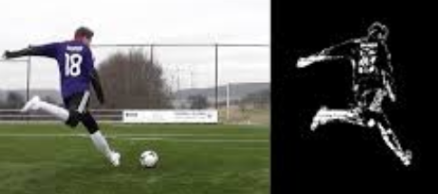
Frame differencing
This is, possibly, the simplest technique we can use to see what parts of the video are moving. When we consider a live video stream, the difference between successive frames gives us a lot of information. The concept is fairly straightforward! We just take the difference between successive frames and display the differences.

Slide 24
If I move my laptop rapidly from left to right, we will see something like this:

Slide 25
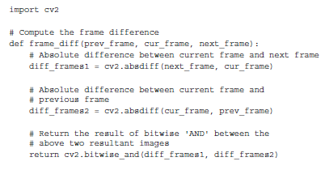
Here is the code to do this:

Slide 26
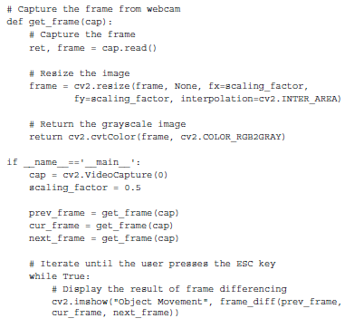

Slide 27
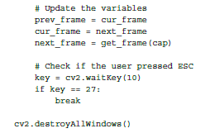

Slide 28
Colorspace based tracking
can convert an image to the HSV space, and then use colorspacethresholding to track a given object.

Slide 29
If you run it through the colorspace filter and track the object, you will see something like this:
Consider the following frame in the video:

Slide 30
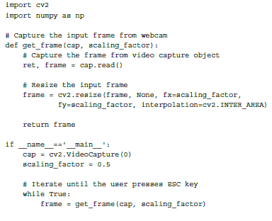
In order to use this tracker, we need to know the color distribution of our target object. Following is the code:

Slide 31
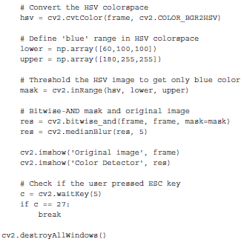

Slide 32
Introduction to YOLO

Slide 33
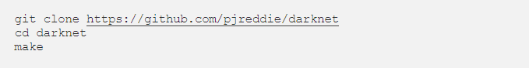
Installation on YOLO
Open Terminal in your working directory, clone the Darknet repository, and build it:
Then, run
and you should have the output:

Slide 34
Testing Model
Tiny YOLOv3
To use this model, first download the weights:
Then run the detector with the tiny config file and weights:

Slide 35
Install YOLO BBox Annotation Tool
Open the terminal and type
$ git clone https://github.com/drainingsun/boobs.git

Slide 36
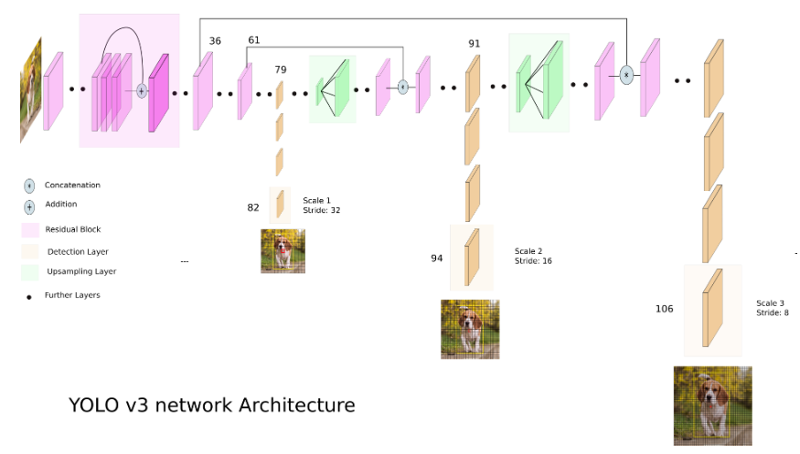
What is YOLOv3?
YOLO applies a single neural network to the full image for both classification and localization.

Slide 37
Creating train.txt and test.txt

Slide 38
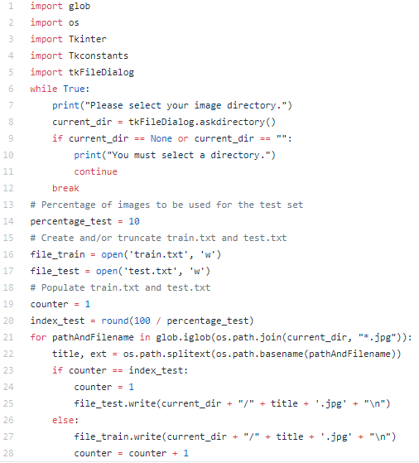
1.) save split.py in your working directory.

Slide 39
2.)open Terminal in the directory of split.py and run:
3.) You should see that two new files have been created in your working directory after selecting the directory of where you’ve saved your images in the pop-up GUI.
4.) move and to the Darknet directory.

Slide 40
Downloading pre-trained weights
5.)Save the weights for the convolutional layers to the Darknet directory:

Slide 41
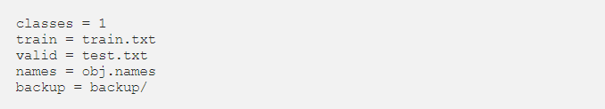
Configuring .data
In your Darknet directory, create and fill in the contents with the following:

Slide 42
Configuring .names
In your Darknet directory, create and fill in the contents with the name of your custom class. For example, the contents of your may simply be:
Object name

Slide 43
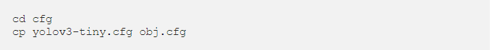
Configuring .cfg
We will now create a file to define our architecture. Let’s get us started.
1.) yolov3-tiny.cfg
Go to the cfg directory under the Darknet directory and make a copy of yolov3-tiny.cfg:
Open obj.cfg with a text editor and edit as following:
In line 3, set batch=24 to use 24 images for every training step.
In line 4, set subdivisions=8 to subdivide the batch by 8 to speed up the training process and encourage generalization.
In line 127, set filters=(classes + 5)*3, e.g. filters=1.
In line 135, set classes=1, the number of custom classes.
In line 171, set filters=(classes + 5)*3, e.g. filters=1.
In line 177, set classes=1, the number of custom classes.
Then, save the file.

Slide 44
9. (Optional) Change configurations to save weights at lower iteration intervals
After you start training, you will notice that YOLO saves the weights at each hundredth iteration until iteration 900. After that, the next set of saved weights will be at iteration 10,000, 20,000, and so on. That’s a long time to wait for each checkpoint. What if you have to pause your training at, for example, iteration 19,900? You would have to resume from iteration 10,000!
To save your weights at lower iteration intervals, open detector.c under the examples directory in the Darknet directory with a text editor.
Then, edit line 138 to describe when you would like your weights to be saved. For example, change if(i%10000==0 || (i < 1000 && i%100 == 0)) to if(i%1000 == 0 || (i < 1000 && i%100 == 0)) to save the weights at each thousandth iteration after 900.
Finally, save the file and run make.

Slide 45
Train models
To start training, open Terminal the directory of Darknet and run:

Slide 46
Waiting

